Slide 1
Linked list
By
Mokadderul Islam
18CSE075

Slide 2
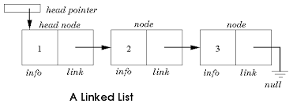
INtrodection
A linked list is a linear data structure.
Nodes make up linked lists.
Nodes are structures made up of data and a pointer to another node.
Usually the pointer is called next.

Slide 3
Array vs linked list
Array
Linked list
Fixed size: Resizing is expensive.
Insertions and Deletions are inefficient: Elements are usually shifted.
Random access.
Sequential access is faster.
Dynamic size.
Insertions and Deletions are efficient: No shifting.
No random access.
Sequential access is slow .

Slide 4
Type of Linked list
There are three different implementations of Linked Lists available, they are:
->Single Linked List.
->Double Linked List.
->Circular Linked List .

Slide 5
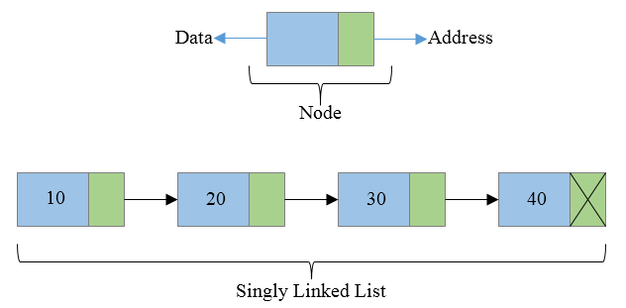
Singly Linked List
Each node has only one link part .
Each link part contains the address of the next node in the list .
Link part of the last node contains NULL value which signifies the end of the node.
Every nodes have a data part and an address part which points to the next node.

Slide 6
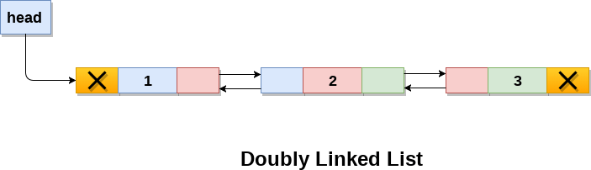
Doubly Linked List
Doubly linked list is a linked data structure that consists of a set ofsequentially linked records called nodes.
Each node contains a data part and two addresses.
The beginning and ending nodes' previous and nextlinks, respectively, point to some kind of terminator,typically a sentinel node or null to facilitate traversalof the list.

Slide 7
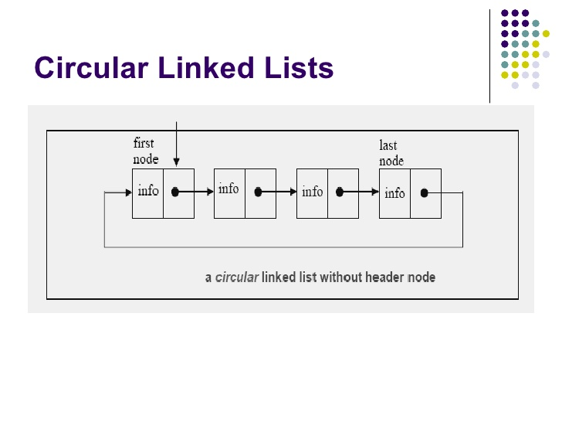
Circular linked Lists
The last node of the list holds the address of the first node.

Slide 8
Insertion
Type of Insertion :
->Insertion at the top of the list
->Insertion at the end of the list
->Insertion in the middle of the list

Slide 9
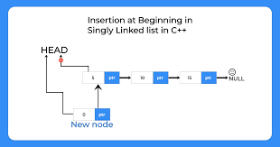
Insertion at the beginning
Make the next pointer of the node point towards the first node of the list .
Make the start pointer point towards this new node.
If the list is empty simply make the start pointer point towards the new node.

Slide 10
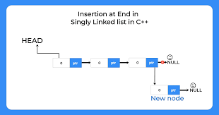
Inserting at the end
Simply need to make the next pointer of the last node point to the new node

Slide 11
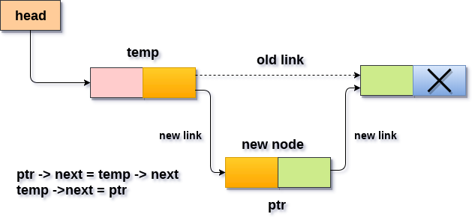
Inserting after an element
Create a Node
Set the node data Values
Break pointer connection
Re-connect the pointers

Slide 12
deletetion
Deleting the first node.
Deleting the last node.
Deleting the intermediate node.

Slide 13
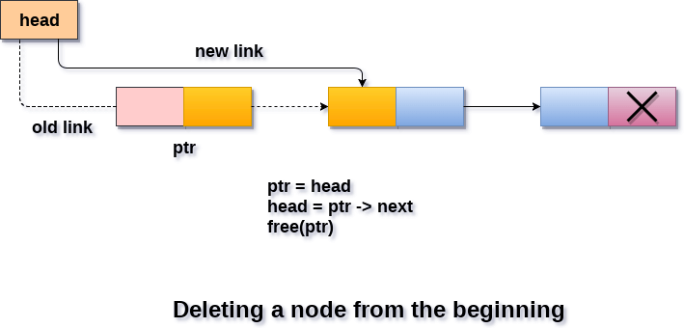
Deleting the first node
Making the start pointer point towards the 2nd node .
Deleting the first node using delete keyword .

Slide 14
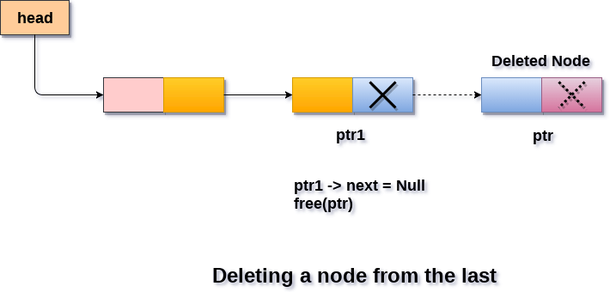
Deleting the last node
Making the second last node’s next pointer point to NULL .
Deleting the last node via delete keyword .

Slide 15
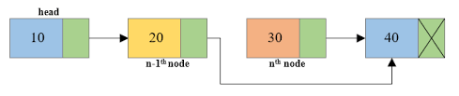
Deleting from the Middle
Set previous Node pointer to next node
Break Node pointer connection
Delete the node

Slide 16
Advantages of Linked list
Save space and easy to maintain.
Don’t need to allocate list size and can declare nodes only as needed .
Insertion and deletion operations can be easily implemented.
Stacks and queues can be easily executed.
They are a dynamic in nature which allocates the memory when required.
Linked List reduces the access time.

Slide 17
Disadvantages of Linked list
Can’t go backwards through the list .
Can’t jump to the beginning of the list from the end.
The memory is wasted as pointers require extra memory for storage.
No element can be accessed randomly ; it has to access each node sequentially.

Slide 18
APPLICATIONS OF LINKED LIST
Applications that have an MRU list.
The cache in your browser that allows you to hit the BACK button.
A stack, hash table, and binary tree can be implemented using a doubly linked list.
Linked lists let you insert elements at the beginning and the end of the list.
In Linked lists we don’t need to know the size in advance.

Slide 19
Thank You

